Slide 1
FIRE & SAFETY ENGINEERING
BSS –DIPLOMA & Adv. Diploma

Slide 2
Overview of Training
What is Safety
Basic Safety Awareness Training & Fire Safety Emergency response plan
Chemical Safety Personal Protective Equipment ( PPE)
Electrical Safety
Machinery Hazards
Work Permit System, Personal Protective Equipment Housekeeping
Quiz Program & Conclusion

Slide 3
SAFETY Targets.
Zero Accident
Zero Occupational Diseases.
Controlling Pollution
Eliminating and Controlling Risk & Hazards

Slide 4
DEFINITIONS
Safety :
the protection of people from physical injury
Freedom from Danger / Freedom from accident.
The Task completed without any accident
Health:
Freedom from Illness
Environmental Protection:
Protection of Surroundings (Air, Land and Water)

Slide 5
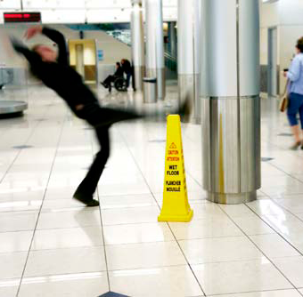
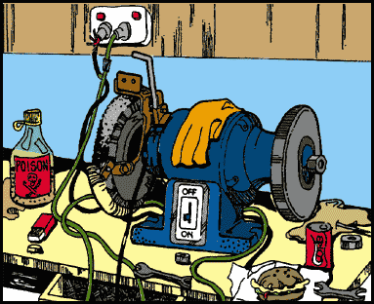
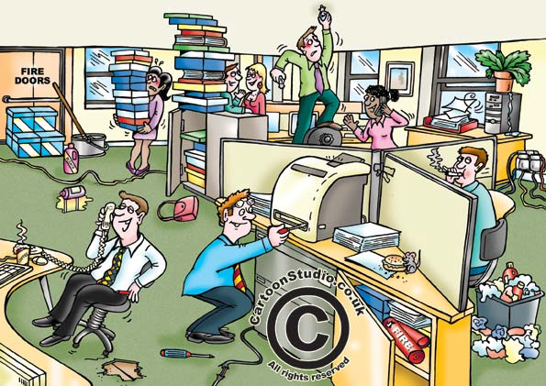
Hazard
Hazard:
Something with the potential to cause harm
Examples : Noise, Vibration Electricity, Dust and fire

Slide 6
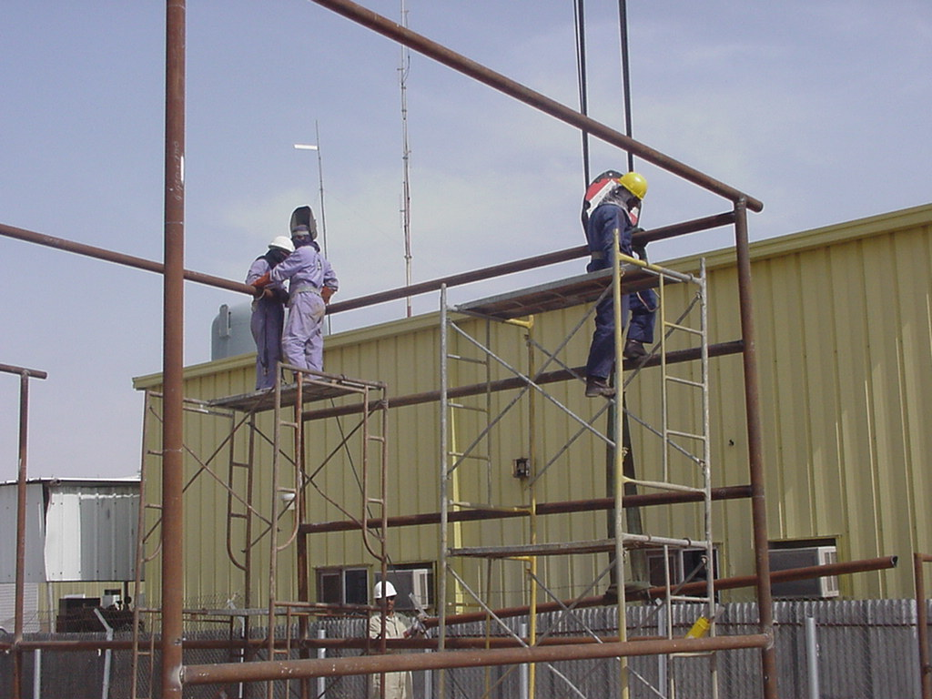
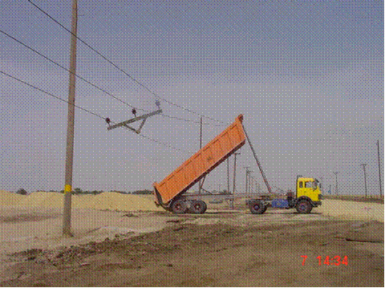
Hazard and Risk
Risk
A combination of the probability
and severity
Risk = Probability X Severity

Slide 7
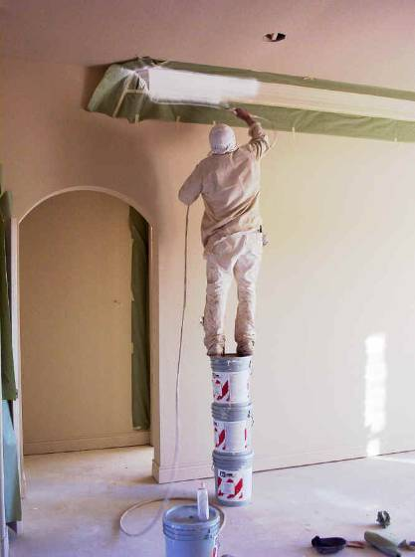
UNSAFE ACT
UNSAFE ACTS: these are where the action (omissions) of the people in the workplace directly cause or contribute to the incident:
Operating without permission
Operating or working at unsafe speed
Not using safety devices
Knowingly using unsafe equipment
Unsafe methods of work
Adopting an unsafe position or posture
Failure to wear safe clothing or PPE
Acting reckless manner (jokes)
Not reporting safety problems
Working under the influence of alcohol

Slide 8
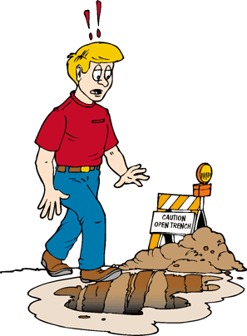
UNSAFE CONDITION
UNSAFE CONDITIONS: These are where the physical conditions at the workplace, or the methods of work, directly cause or contribute to the incident.
Unguarded Machinery or absence of guard
Inadequate guarding (height, strength)
Unsafe equipment (defective, not maintained)
Unsafe floors (slippery, cracked)
Unsafe system of work
Unsafe PPE (not providing, inadequate)
Bad housekeeping (dirt, blocked ways)
Unsafe layout and design of workplace
Unsafe environmental conditions

Slide 9
Accident / incident Reporting
every injury no matter how slight must be reported immediately

Slide 10
Accident / incident Reporting
.
ALL accidents and incidents MUST be reported, as soon as possible by the individual involved or someone on his/her behalf.

Slide 11
Accident / incident Reporting
If you see an incident
Inform your supervisor

Slide 12
Accident / incident Reporting
Investigation is required to identify the root cause to prevent re-occurrence

Slide 13
Incident must be reported
Unsafe act

Slide 14
Incident must be reported
Unsafe Condition

Slide 15
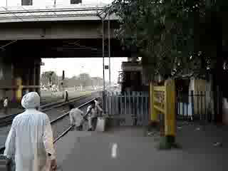
Incident must be reported
Near Miss

Slide 16
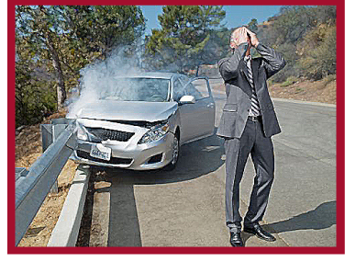
Incident must be reported
Property damage

Slide 17
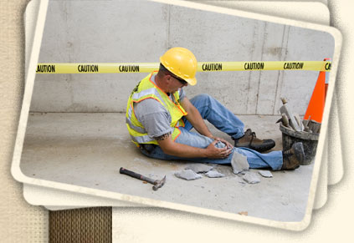
Incident must be reported
Accident

Slide 18
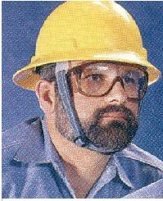
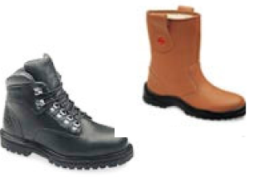
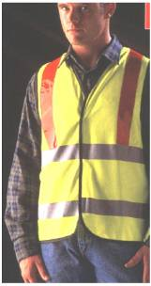
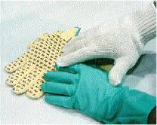
Personal Protective Equipment (PPE)
Wear your Safety Helmet, Safety Glasses, Safety Boots/Shoes, High visibility vest and gloves.

Slide 19
PPE,s ( Personal Protective Equipments/Life Saving quipments)
What are the PPE,s

Slide 20
What are PPE,s
Hard Hats
Safety Glasses
Safety Goggles
Face Shields
Gloves
Earplugs and Ear Muffs
Respirators
Aprons, Safety belts and Full Body Harness

Slide 21
Head Protection ( Hard Hats)
Hard Hats protect from
Falling and Flying objects
Bumping of head against fixed objects
Resists Penetration
Absorb shock and blow
Exposed electrical wires

Slide 22
Head Protection ( Hard Hats)
Types of Helmets
Type 01 ( Helmets with full brim)
Type 02 ( Brimless Helmets)

Slide 23
Head Protection ( Hard Hats)
Classes of helmets
Class A (Plastic or Fiber Helmets)
Construction, Mining, Shipbuilding, and industries
Class B ( Hard Plastic )
Electrical helmets protect from high voltages

Slide 24
Head Protection ( Hard Hats)
Class C ( Made of Light weight aluminum)
Designed for comfort, offers limited protection
• Protects against bumps from fixed objects, but does
not protect against falling objects or electrical shock

Slide 25
Eye and Face Protection
Protects from
Flying particles, Molten metal, Liquid chemicals, Acids, Chemical Gases and vapors,
Light radiations,
Caustic burns
Chemical Burns

Slide 26
Eye Protection Criteria for Selection
Protects against specific hazard(s)
• Comfortable to wear
• Does not restrict vision or movement
• Durable and easy to clean and disinfect
• Does not interfere with the function of
other required PPE

Slide 27
Eye and Face Protection
Types of Eye and Face Protectors
Safety Glasses
Safety Goggles
Face Shields
Welding Goggles
Laser safety Glasses

Slide 28
Foot Protection (Safety Shoes)
Protects from
Heavy objects such as barrels or tools
that might roll onto or fall on employees’
feet
• Sharp objects such as nails or spikes that
might pierce ordinary shoes
• Molten metal that might splash on feet
• Hot or wet surfaces
• Slippery surfaces

Slide 29
Foot Protection (Safety Shoes)
Types of Safety Shoes
Insulated Rubber Sole
Long Synthetic Material
Metal Plated Sole
Steel Caped toes

Slide 30
Hand Protection ( Gloves)
Gloves Protects from
Burns
Bruises
Abrasions
Cuts
Punctures
Fractures
Amputations
Chemical Exposures
Extreme heat and cold

Slide 31
Hand Protection ( Gloves)
Types of Gloves
There are 3 main following types of gloves
Metal Mesh , Leather or Canvas Gloves
Fabric and Coated Fabric Gloves
Chemical and Liquid resistance Gloves
Insulated Rubber Gloves

Slide 32
Metal Mesh, Leather or Canvas Gloves
These gloves are made up of metal mesh, leather or canvas and protects from burns, cuts, and sustained heat. It has further three types.
Leather Gloves: These gloves protects from sparks, moderate heat, blows, chipping, and rough objects, .
Uses: Used for welding, cutting, chipping work, and grinding work

Slide 33
Metal Mesh, Leather or Canvas Gloves
2. Aluminized Gloves: These gloves are made of a metal mesh or a kind of aluminum.
Uses: These gloves are used for welding, furnace and foundry operations, and other cutting work. These gloves required a kind or leather gloves to be inserted under them.

Slide 34
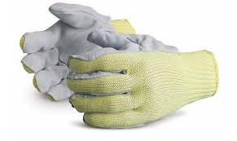
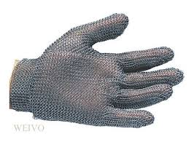
Metal Mesh, Leather or Canvas Gloves
3. Aramid fabric gloves:
These gloves are made of a kind of synthetic material.
Uses: These gloves protects against heat and cold.

Slide 35
Fabric and Coated Fabric Gloves
Fabric and coated fabric gloves are made of fabric and cotton. It has further two types .
Fabric Gloves: These gloves are made of cotton or fabric.
Uses: These gloves are used for the protection form dirt, moderate heat, and friction.
These gloves can also be used to work with rough, sharp, and heavy materials.

Slide 36
Fabric and Coated Fabric Gloves
2. Coated Fabric Gloves: These gloves are made up of fabric or cotton and on the other side coated with plastic type material.
Uses:
Coated fabric gloves are used bricks and blocks handling, masonry work, wire rope handling and many other operations.

Slide 37
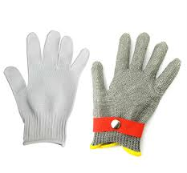
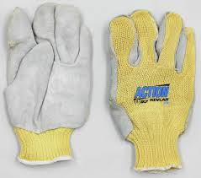
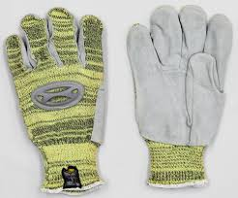
Fabric and Coated Fabric Gloves

Slide 38
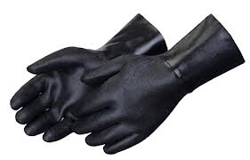
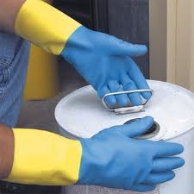
Chemical and Liquid Resistance Gloves
These gloves are made of rubber like latex, nitrile, butyle, or plastic. It has further following types.
Neoprene Gloves:These gloves are used to protect workers from burns, irritation, and other skin problems caused by oils, gases, solvents, and other chemicals.

Slide 39
Chemical and Liquid Resistance Gloves
Butyle Rubber Gloves:
These gloves protect against nitric acid, sulfuric acid, hydrofluoric acid, and many other kinds of acids.

Slide 40
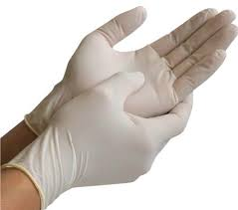
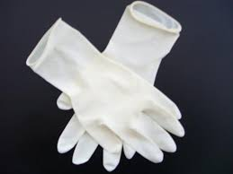
Chemical and Liquid Resistance Gloves
3. Natural Latex or rubber gloves:
These gloves are used handle acids, alkalies, salts, and ketones.
These gloves are also used for sandblasting, grinding, and polishing work.

Slide 41
Chemical and Liquid Resistance Gloves
4. Nitrile Rubber Gloves:
These gloves protects from tears, punctures, and snags.
These gloves are also used for different chemicals.

Slide 42
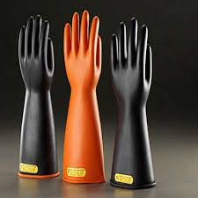
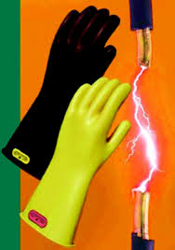
Insulated Rubber Gloves
Insulated rubber gloves are made of special kind or rubber which gives protection against the electricity.

Slide 43
Respiratory Protection Devices
Respiratory protection devices are used to protect the workers from different kinds of gases, vapors, and fumes and in some conditions to provide them oxygen. It falls into two types.
Air Purifying Devices
Air Supplying Devices

Slide 44
Air Purifying Devices
Air purifying devices are basically used to purify the air from different kinds of harmful elements. Its has following five types.
Mechanical Filter Cartridge
Chemical Filter Cartridge
Combination of mechanical and chemical
Gas Mask
Powered Air Purifying Respirator ( PAPR)

Slide 45
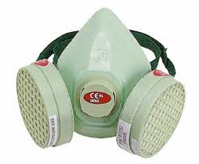
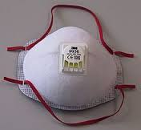
Air Purifying Devices
Mechanical Filter Cartridge: This kind of respirator filters the air mechanically and removes the harmful particles like, dusts, mists, metal fumes, smoke etc. But it gives no protection against gases.

Slide 46
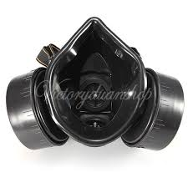
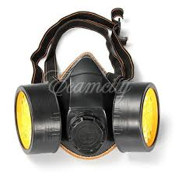
Air Purifying Devices
2. Chemical Filter Cartridge:
These filters uses chemical filter to remove different kinds of gases and vapors from the air.

Slide 47
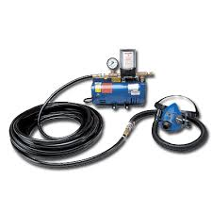
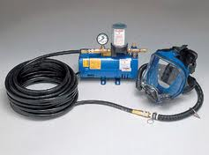
Air Supplying Devices
Supplied Air respirators
The supplied air respirators are used in different places like air plane, hospitals, confined spaces etc.
The air is supplied from an external source through the pipes or hoses and then to the mouth piece.

Slide 48
Air Supplying Devices
2. Self Contained Breathing Apparatus SCBA
SCBA contains a cylinder and a mouth piece.
The user or workers become totally independent of the outside atmosphere as the air or oxygen is self contained and carried by the worker.
It is used in confined spaces or at the places where there is a deficiency of oxygen.

Slide 49
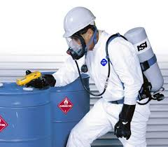
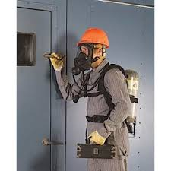
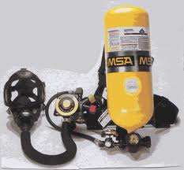
SCBA

Slide 50
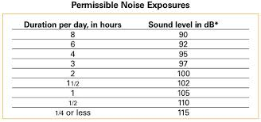
Hearing Protection
When it’s not feasible to reduce the noise or its duration – use ear protective devices.
Ear protective devices must be fitted properly.

Slide 51
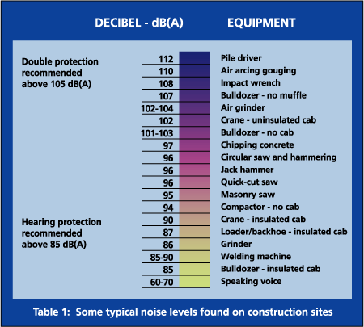
Hearing Protection

Slide 52
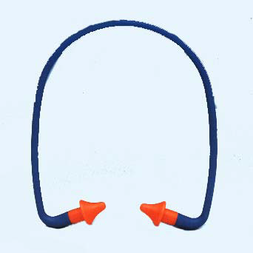
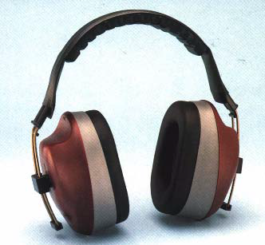
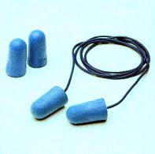
Hearing Protection
Examples of Hearing Protectors
Ear muffs Ear Plugs Ear Canals

Slide 53
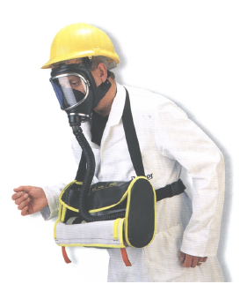
Personal Protective Equipments (PPE)
Wear protective clothing at all times and / or special protection mentioned on permit.

Slide 54
Personal Protective Equipments (PPE)
Change damaged PPE immediately

Slide 55


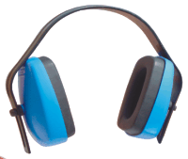

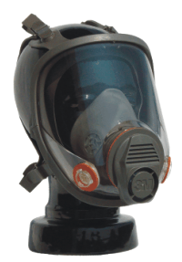
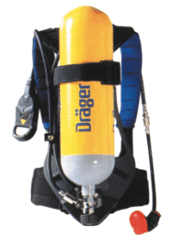

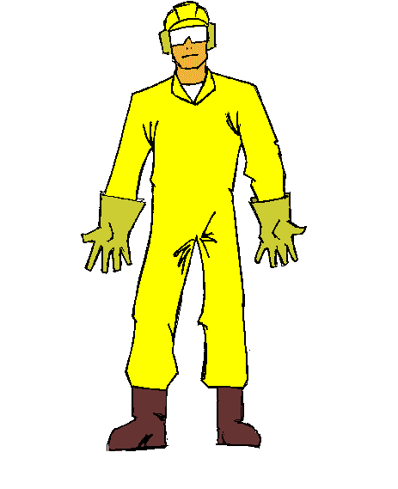
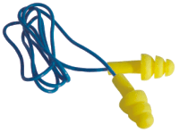

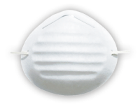
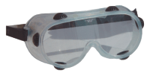


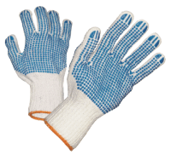
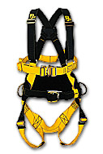

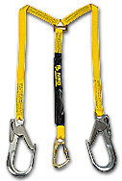










HEAD TO TOE GOOD TO GO!
HEAD
FACE
WHAT KIND OF PPE DO I NEED?
RESPIRATORY
HEARING
EYE
BODY
HAND
FOOT

Slide 57
Contents
Purpose
Objective
Responsibility
Permits & Certificates
Flow of Work Permit
Coordination Meeting
CWP; HWP

Slide 58
Contents
Excavation
Electrical Isolation
Confined Space Entry
Safe Lifting
Hazards in Radiography
T.B.T & JHA

Slide 59
Purpose
The purpose of a Work Permit is to ensure
that the risk is reduced to an acceptable level and remains under control while performing activities.
Safe working environment is achieved by providing management control over the various work activities.
It is also as a legal and compulsory document to be observed and used by all Subcontractors.

Slide 60
Objectives & Functions
To ensure
Authorization is given to carry out the work
Job Performer clearly understand the nature of the work & Hazards of the job
Precautions are taken to start the job safely, perform the job safely & close out based on the hazards.
Supervisors are fully aware of the work being done.
Control The work permit

Slide 61
Responsibility
Personnel should be aware that the Permit to Work system is not an absolute safeguard in itself.
It is the responsibility of each individual to be alert to hazardous situations that may arise during the operation.

Slide 62
Responsibility of P.H.
Permit Holder (Job Performer): Once a permit has been issued the person(s) carrying out the work shall ensure that the work is carried out safely.
Should understand the permit condition.
Shall carry out and supervise the works in compliance with the relevant permit prescription
.

Slide 63
ISSUING AUTHORITY
An authorised person to carry out the task as required by the Permit to Work Procedure.
Responsible for reviewing the submitted Permit after confirming that the worksite has been examined and all precautions are identified.
Confirm that no conflict exists with other Permits.

Slide 64
Permit Coordinator
Person authorised by the Contractor Project Manager for Construction to coordinate issue of all Permits to identify potentially conflicting work tasks, both on a geographical and time basis.

Slide 65

ROLES AND RESPONSIBILITIES
Authorized Gas Tester
After appropriate training, the Authorized Gas Tester is authorized to test for the presence of flammable gas or vapor, toxic gas and oxygen in Confined Spaces.
Should record all the readings in the permit
Fire Watchers
Personnel appointed as Fire Watchers shall be adequately trained and shall monitor work areas, and the precautionary measures taken in those areas, when specified by the Issuing Authority on the PTW. Fire Watchers shall undertake fire response activities as required.

Slide 66
Fire Watch / Safety Watch
Supervisor will nominate a competent person.
The person on fire watch shall remain in attendance during the hot work period.
Conduct gas tests within a 15 m radius of the work site at regular interval as mentioned in the Permit.
Maintain visual surveillance of the work area
Be in a position to quickly shut down the tools or equipment being used & monitor any sparks that may escape from an enclosure
Be in radio contact with the Control Room.
Ensure there is ready access to the fire fighting equipment

Slide 67
Project Manager Responsibility
Ensure the proper coordination of construction activities between Contractor and subcontractors;
Verify that the subcontractor is providing the correct information and equipment for the scope of work;
Ensure training is given to all persons requiring to use a Permit to Work

Slide 68
FIELD HSE MANAGER
Ensure adequate training to all personnel involved in this procedure;
Ensure that suitable and sufficient inspections and audits are carried out;
Evaluate the effectiveness of this procedure and change amend as is required or becomes necessary to achieve its purpose;
Advise the contractor management of any irregularities or areas of concern in order to investigate and to implement corrective actions; remove any permit signatory from the list, found to be in breach of the required duty and responsibility.

Slide 69
Permit Display Status Board
Copy of the Live Permits with the copy of the attachments.
All the out Standing Permits.
PC & PA are responsible to update the status board on their locations.
 Back
CEIL Training

Slide 70

Piper Alpha Disaster

Slide 71
Analysis of Piper Alpha Disaster
Permits
There are two permits (one only identified)
Flow of PTW
Close out of Permit system
Non availability of permit status board
Communication gap (no one is known that PCV is removed)
Improper Blind (not standard)

Slide 72
WORK PERMIT SYSTEM
HOT WORK PERMIT (PRINCIPLE PERMIT)
COLD WORK PERMIT
RADIOGRAPHY PERMIT
MISCELANEOUS CERTIFICATES (SECONDARY)
Notes:
10/08/99
13
Saipem

Slide 73
TYPES OF WORK PERMITS
GENERAL WORK PERMIT ( COLD)
HOT WORK PERMIT
RADIOGRAPHY WORK PERMIT
ELECTRICAL WORK
EXCAVATION WORK PERMIT
CONFINED SPACE ENTRY
WORKING AT HEIGHT
LIFTING CERTIFICATE
Notes:
10/08/99
12
Saipem

Slide 74
Supplementary Certificates
For the below five critical activities, supplementary certificates are provided for the extra safety.
These certificates are to be attached along with the Hot or Cold work
ELECTRICAL WORK CERTIFICATE
EXCAVATION WORK CERTIFICATE
CONFINED SPACE ENTRY CERTIFICATE
WORKING AT HEIGHT CERTIFICATE
LIFTING CERTIFICATE

Slide 75
Cold Work Permit (BLACK)
A Cold Work Permit, shall be used for tasks that do not involve hot work but have high risk potential, need to be covered by a permit.
Such Cold Work tasks / activities are such as :
Any constructional activities, scaffolding erection, pressure test etc.

Slide 76
Hot Work Permit (RED)
A Hot Work Permit, will be required for all works involving the use of a naked flame or potential ignition sources in areas where flammable or combustible materials may be present.
Activities that may produce or expose a possible source of ignition include, but are not limited to, the following:

Slide 77
Works requiring a Hot Work Permit
Welding / flame cutting.
Electrical pre-heating / stress relieving.
Use of heat shrink blowers.
Grinding (e.g. abrasive wheel).
Opening live junction boxes.
Use of air or hydraulic powered metal cutting, chipping or caulking tools.
Use of electrical soldering irons.
Use of explosives and perforating guns.
Use of powered steel wire brushes.
Dry grit / shot blasting.
Sand blast
Use of battery powered camera with or without flash.
Use of mobile phones.
Needle gunning.
Jack Hammer
Other sparks-producing activities as recognized by SAIPEM

Slide 78
WORK PERMIT SYSTEM
HEATING
GRINDING
BURNING
HOT WORK
WELDING
USE OF
ELECTRICAL
POWER TOOLS
NEEDLE GUN
GAS CUTTING
Notes:
10/08/99
15
Saipem

Slide 79
Condition for permit to seize (invalidation)
Gas testing & work commencement period:- 30 minutes
The conditions on the permit are not complied with;
Area or unit conditions change, e.g. Venting or spillages of hazardous materials occurred etc
Plant fire & gas leak and the emergency alarm is released;
Work is carried over to the next shift; in this case the permit to work can be renewed; the renewal shall be done before the next shift is starting its activity.

Slide 80
Excavation Certificate
An Excavation Certificate, is required for all excavation and trenching work having more than 15 cms depth.
There may be a potential for damage to underground utilities or facilities, collapse of banks, etc
.
Permit should be applied 48 hrs prior to the excavation. It should be signed by Mechanical, Electrical, Instrument & IT supervisors.
Floor openings, holes and edges.

Slide 81
Precautions for excavation
Check for over head lines when doing excavation
Barriers should be provided 1.5 m away from the edge of the excavation.
Mechanical excavation should be 5 m away from the buried live cables.
With in 5 m use only hand excavation with extra care.
The minimum distance from the crane boom to power cable is 6 m.

Slide 82
Excavation & Trench
Excavation:
Width is greater than the depth and also when the depth exceeds 4.5m.
Trench:
Depth is greater than the width as long as the width is not greater than 4.5m.

Slide 83
Electrical Certificate
30% of electrical accidents result in fatalities
An Electrical Certificate, will be required for all works involving in the electrical equipment and supply. Such Electrical Work includes, but is not limited to, the following:
Work on isolated electrical equipments
Earthling / grounding
Maintenance
Continuity checks
Installation.
Installation of instrumentation pipe work, cable and terminations (no live tie-ins).

Slide 84
WORK PERMIT SYSTEM METHODS OF ISOLATION
Competent
personnel
Secure the
equipment isolation
from power
Discharge
electric
energy
ELECTRICAL
ISOLATION
Use appropriate
rated test
equipment
Use isolated
mats, screens,
glove
and tools
Safe working system
Notes:
10/08/99
18
Saipem

Slide 85
Confined Space Certificate
A “confined space” is defined as any space:
• Large enough and so configured that an employee
can bodily enter and perform assigned work.
• With limited or restricted means of ingress or egress.
• With limited or no natural ventilation.
• Not designed for continuous occupancy.
Excavations, trenches (normally deeper than 1.2
meters considered as confined space)

Slide 86
Confined Space Certificate
A Confined Space Permit, will be raised when it is necessary for personnel to enter confined spaces (for work or inspection purposes).
As per the Confined Space Entry Procedure, a Hazard and Risk Assessment must be completed before any entry into a confined space .

Slide 87
LIFTING CERTIFICATE
Objective: Ensure correct work practices to be followed for safe lifting operation.
Pre Check before raising permit for lifting
Inspected soil for adequate
Crane load indicating device with overload cut-off
Signs & barriers are installed
Radius of the lift beam measured by tape
Weight of the load calculated & documented

Slide 88
Safe Lifting Operation
Tandem lifting shall only be with the consent of Company.
A check must be made to ensure that the crane complies with assessed requirements and is fitted with the correct length of boom or jib.
A copy of the current Crane Test Certificate must be available at the site for examination.
The crane must have been inspected within the previous seven days

Slide 89
Radiography / Ionization Radiation
Purpose:
To provide instruction for controlling Non Destructive Testing on site detailing the requirement for the safe handling and monitoring of all radioactive sources for protecting personnel from radiation hazards.
I.R. includes alpha, beta, gamma, and x-rays, but does not include sound or radio waves, visible light, or infrared or ultraviolet light.

Slide 90
Radiation
Radiation is categorized into two groups:
Non-ionising: This does not cause ionization as it passes through the body. Examples are visible,
infrared and ultraviolet light.
Ionising: This ionizes matter as it passes through, and can therefore damage body tissue.
Examples are alpha, beta particles and electromagnetic radiation such as x-rays and gamma.

Slide 91
WORKING AT HEIGHT
To establish minimum requirements and guidelines to provide maximum prevention/ protection against falls from elevation.
Minimum standard of training necessary to ensure personnel understanding and compliance with the program.
The goal is to achieve 100% fall prevention to potential falls

Slide 92
Primary & Secondary Fall prevention
Primary Elimination of fall: Use of guardrail systems, aerial lifts, scaffolds or alternate work methods such as pre-assembly at ground level.
Secondary Elimination of fall: Utilization of fall arrest equipment such as
Full body harness and
Shock absorbing lanyard as a backup to primary fall
To be used at all-time while working at height of > 1.8 mt

Slide 93
Anchorage point
The followings shall NOT be used for anchorage points.
Screw Pipe, Conduit Pipes, Bolt heads, Cable Trays
Welded Pipe Less Than 2” & Wooden Handrails etc
100 mm dia pipe should be used for anchorage.
Anchoring should be just above the head
Wider the anchoring will cause swing more & Cause accident.

Slide 94
JHA /JSA
A process where the
Hazards associated with each step of a job are identified
Control measures are put in place to mitigate the risk to PEME . (Person, Equipment, Material & Environment)

Slide 95
Main Steps for JHA
Divide the job into steps of the activity
Identify hazards for each step
Write the control measures for each Hazard identified in the steps.

Slide 96
TOOL BOX TALK
Review the previous TBT for that activity
Identify the tools & Hazards of the activity
Simultaneous activity in that area
Time to start & time to finish
Emergency action

Slide 97
TAG OUT AND LOCK OUT PROCEDURE
OBTAIN CERTIFICATE FOR ISOLATION
PERFORM THE ISOLATION AND SECURE WITH PADLOCK
ATTACH TO THE PADLOCK THE PART 2 OF IDENTIFICATION LABEL
PUT THE PART 1 OF IDENTIFICATION LABEL, THE PADLOCK KEY AND THE COPY OF CERTIFICATE IN THE LOCK OUT BOX
Notes:
10/08/99
21
Saipem

Slide 98
LOCK OUT & TAG OUT (LOTO)

Slide 99
Definition
Lockout/tagout procedures are intended to prevent accidents and injuries caused by accidental release of energy.
Any powered machinery (electrical, hydraulic, water, pressure) or electrical equipment that could move in a way that would put people in danger is a hazard that can be prevented by lockout/tag out.
Notes:
A study of the many deaths and disfiguring injuries determined the most common causes were as a result of failure to follow the established lockout/tagout procedures. Most of the accidents occurred with moving machinery, electrical equipment, and vehicles.

Slide 100
How Does Lockout Work?
Lockout
Refers to the process of blocking the flow of energy from a power source to equipment, keeping it isolated from the power source.
Accomplished by using a lock or similar device
Padlocks
Multiple hasps
Blocks (pancake)
Blinds
Valve blocking device
Chains

Slide 101
How Does Tagout Work?
Tagout
Refers to the process of placing a tag on an energy source
Tag serves as a warning
Not a physical restraint
Administrative control of hazards

Slide 102

Energy Control Program
Isolation of non-electrical equipment
Lockout of electrically-driven equipment
Isolation procedure
Safety/Departmental Permits
Confined space entry
Purging, venting, isolating various
pipes/lines

Slide 103
What You Must Do
Make sure you understand what the tags and locks mean.
When in doubt, ask your supervisor or the HSE Department.
Strict adherence of the lockout/tagout procedures are expected at all times.
Disciplinary actions will be taken for failure to follow the procedures.
You will receive more detailed training on this project’s lockout/tagout procedure.

Slide 104
Contents of Tag
The padlock has to be provided with a tag reporting:
ID number as recorded in the isolation log book.
Date and time of lock out.
Name and signature of the individual who installed the padlock and the reason of the installation

Slide 105
Tags
When you find a tag of an equipment found in the ground, what is your action?
Hand over to the responsible person who signed in the tag.

Slide 106
Electrical Safety.

Slide 107

The Hazards of Electricity
PRIMARY HAZARDS
Electric shock
Electric fire & explosion
Electric flash
Electric burns

Slide 108
The Hazards of Electricity
Secondary Hazards
Person falling from height
Dropping of tools & objects
Health hazards due to release of toxic gas & production of UV rays
Psychological effects

Slide 109
Severity of Shock Influenced By:
Voltage – the higher the voltage, the greater the current
Duration – the length of time that a person is exposed
Resistance – skin condition, clothing, etc.
Environmental factors – metal surfaces, humidity, etc.
Notes:
Also mention that secondary hazards exist which may result in other injuries, such as work at height (person may fall if receiving a shock)

Slide 110
Electrical Terms…
Conductors:
A material that allows electricity to flow easily:- e.g. cooper, steel, water
Insulators:
Materials that not allows electricity to flow easily: e.g. plastic, rubber, wood.

Slide 111





Electrical Safety.
✗
Connections must be well protected & covered.
Do’s & Don’ts
All electrical work must be carried out by competent electricians
Temporary electrical panels, extension cables and other electrical tools must be checked and inspected prior to use
ELCB’s Must be installed in all panels
Follow Lock out & Tag out procedures
✗
One cable,
One tool
Never carry or lower a power tool by its cable.
✗
Do Not Touch Electrical Appliances if You Are Not Authorized & Competent
Ensure power
tools are DRY.
Ensure power tools are
inspected “PRIOR” to use.

Slide 112
Electrical Safety
Display electrical equipment & cable routing layout
All electrical installation to be tested & commissioned as per BIS codes
All DB’s should be covered
Earthing of all electrical installations
Regular maintenance

Slide 113
ELECTRICAL SAFETY
Records to be maintained, ELCB
Display caution boards
Provide ELCB for portable equipment
Follow rules and regulations
Follow safety measures
Adopt protective system
Insulation
Regular inspection

Slide 114


User Checks
Damage to cable sheath
Damage to plug
Cable not fully insulated
Inadequate joints
Unsecured cable
Wet or contaminated
Damage to casing of equipment
Burns/scorch marks
Notes:
Some items of electrical equipment should be visually inspected by the user routinely before use. This is particularly important for portable electrical equipment that is used in environments where damage can easily occur (such as a power tool used on a construction site).
This user check does not involve any form of dismantling, but just careful visual inspection of the equipment. If visual inspection or tests show that the equipment is unsafe, then it must be taken out of service and repaired or discarded.
Initially the equipment should be checked for suitability to ensure that it is appropriate for the task in hand, and that the equipment conforms to the relevant standards e.g. CE marked if for use in Europe.

Slide 115

Notes:
115

Slide 116
Accident Prevention
Slips, trips, and falls are the number one preventable accident in the workplace
Good Housekeeping is the basis for preventing slips, trips, and falls:
Cleaning up spills immediately
Marking wet areas
Mopping or sweeping debris from floor
Removing obstacles from walkways and keeping them free of clutter
Securing mats and rugs to floor to lay flat on floor
Covering/ taping down cables across walkways
Keeping work areas well lit
Put away tools

Slide 117


Warning Signs
YELLOW-Warning

Slide 118
Warning Signs
Red
Prohibition Sign
Prohibits behavior likely to increase or caused danger, e.g. stop, shut-down, emergency cut-out devices, evacuate
Red
Fire Sign
Identifying the location and type of fire fighting equipment
Yellow
Warning Sign
Giving warning of a hazard or danger, e.g. be careful, take precautions, examine
Blue
Mandatory Sign
Must be done, prescribing specific behavior, e.g. wear personal protective equipment
Green
Safe condition Sign
Information on emergency exits, first-aid, or rescue equipment and activities

Slide 119
Special Assignments
Concerned Supervisor shall conduct tool box talk to brief:
Special PPE requirement

Slide 120




Follow the Color coding system for the different types of waste
Classification of waste bin
Colour of waste bin
Pictogram at waste bin
Type of waste collected
Recyclable including scraps
Paper, plastic, wood, bottles, metal, rubber etc.
Bio Medical Waste
Used cottons, bandages, shredded needles, syringes etc.

Slide 121

Housekeeping
Poor Housekeeping Creates Hazards

Slide 122


Housekeeping
Tidy up your own mess, avoid slip, trips and falls

